Slide 1
Lecture 4-6
Introduction to relational Model

Slide 2
Outline
Structure of Relational database
Database Schema
Relational Keys
Integrity Constraints
Relational Query Languages
The Relational Algebra
Select Operation
Project Operation
Union Operation
Set Difference Operation
Set intersection Operation
Cartesian Product Operation
Rename Operation
Join Operations

Slide 3
Structure of Relational database
Relation: a relation is a table with columns and rows.
Attribute: an attribute is a named column of a relation.
Domain: a domain is a set of allowable values for one or more attribute.
Tuple: A tuple is a row of a relation.
Degree: The degree of a relation is the number of attribute it contain
Cardinality: The cardinality of a relation is the number of tuples it contain
Relational database: a collection of normalized relations with distinct relation names.

Slide 4
Structure of Relational Database
Attributes
(column
headers)
Name | Address
John | Washington
Ella | Boston
Tuples
(rows)
Relation Instance
Customers
Relation
name

Slide 5
Database Relations
Relation schema: A named relation defined by a set of attribute and domain name pairs.
Relational database schema: A set of relation schemas, each with a distinct name.

Slide 6
Relational Keys
SuperKey: An attribute, or set of attributes, that uniquely identifies a tuple within a relation.
Candidate Key: A superkey that no proper subset is a superkey within the relation
Primary Key: The candidate key that is selected to identify tuples uniquely within the relation.
Foreign Key: An attribute, or set of attributes, within one or more relation that matches the candidate key of some (possibly the same) relation.

Slide 7
Integrity Constraints
Nulls: Represents a value for an attribute that is currently unknown or is not applicable for this tuple.
Entity Integrity: In a base relation, no attribute of a primary key can be null.
Domain Integrity: refers to the rules defined for the values that can be stored for a certain attribute
Referential integrity: If a foreign key exists in a relation, either the foreign key value must match a candidate key value of some tuple in its home relation or the foreign key value must be wholly null.

Slide 8
Relational Query Languages
Procedural
Relational algebra
Non-procedural, or declarative
Relational calculus
Tuple relational calculus
Domain relational calculus
Query languages used in practice include elements of both the procedural and the nonprocedural approaches

Slide 9
Relational Algebra
Six basic operators
select: σ
project: ∏
union: ∪
set difference: –
Cartesian product: x
rename: ρ
The Selection and Projection operations are unary operations, as they operate on one relation, other operations work on pairs of relations and are therefore called binary operations
The operators take one or two relations as inputs and produce a new relation as a result.

Slide 10
Select Operation
Notation: σ _{p}(R)
p is called the selection predicate or condition
The select operation selects tuples that satisfy a given predicate.
We use the lowercase Greek letter sigma (σ) to denote selection.

Slide 11
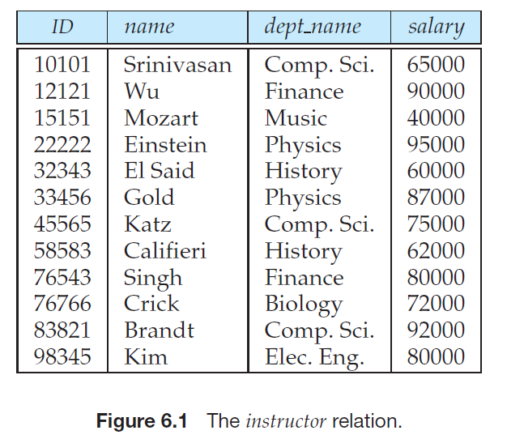
Example
List those tuples of the instructor relation where the instructor is in the “Physics” department.
σ_{dept name =“Physics”} (instructor )

Slide 12
Select tuples having salary greater than $85000
σ_{salary>85000} (instructor )

Slide 13
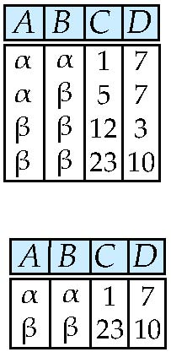
Select Operation
In general, we allow comparisons using =, =, <, ≤, >, and ≥ in the selection
predicate. Furthermore, we can combine several predicates into a larger predicate
by using the connectives and (∧), or (∨), and not (￢).
Relation r
σ_{A=B ^ D > 5} (r)

Slide 14
Example
find the instructors in Physics with a salary greater than $90,000.
σdept_name=“Physics”∧ salary>90000 (instructor )

Slide 15
Project Operation
Notation:
where A₁, A_{2,} ….,A _{k} are attribute names and R is a relation name.
Duplicate rows removed from result, since relations are sets

Slide 16
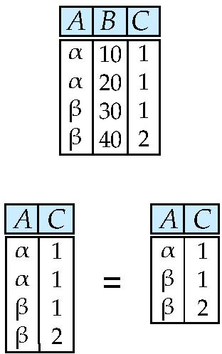
Project Operation
Relation r:
∏_{A,C} (r)

Slide 17

Example
List all instructors’ ID, name, and salary, from the instructor relation

Slide 18
Union Operation
Notation: r ∪ s
Defined as: r ∪ s = {t | t ∈ r or t ∈ s}
For r ∪ s to be valid.
1. r, s must have the same arity (same number of attributes)
2. The attribute domains must be compatible (example: 2nd column of r deals with the same type of values as does the 2nd column of s)

Slide 19
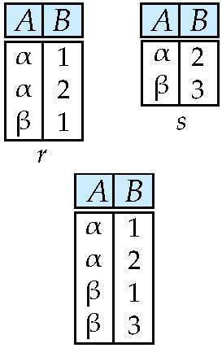
Example
Relations r, s:
r ∪ s:

Slide 20
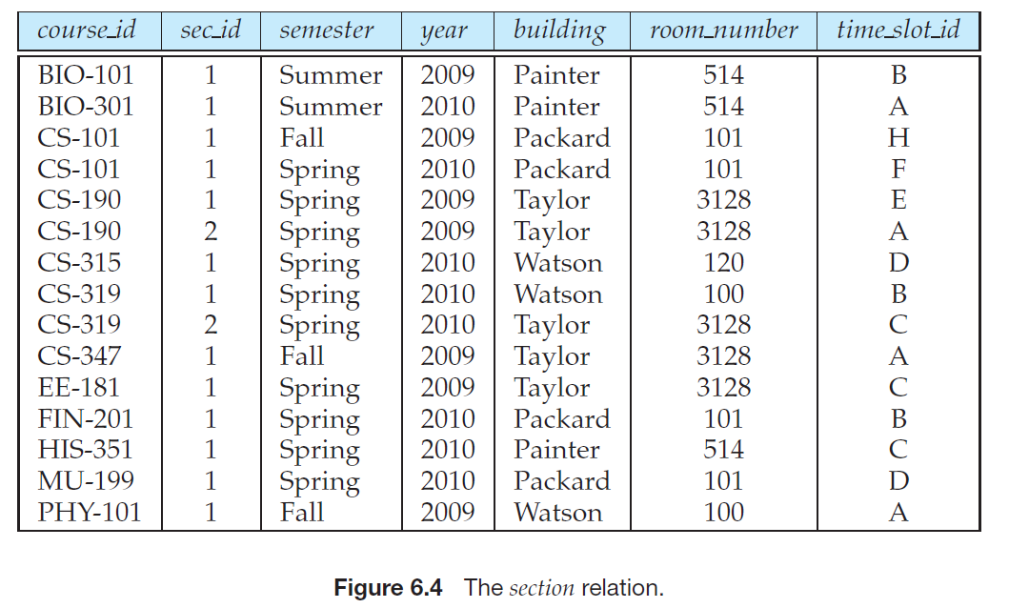


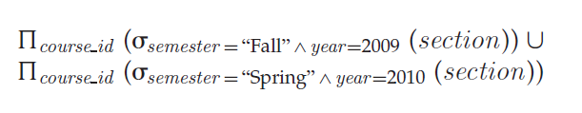
Example
find the set of all courses taught in the Fall 2009 semester, the Spring 2010 semester, or both.

Slide 21
Exercise
Write the following queries in relational algebra, using the university schema.
a. Find the titles of courses in the Comp. Sci. department that have 3 credits.
b. Find the IDs of all students who were taught by an instructor named Einstein;make sure there are no duplicates in the result.
c. Find the highest salary of any instructor.
d. Find all instructors earning the highest salary (there may be more than one with the same salary).

Slide 22
Suggested Reading
Chapter 5 of Database Systems: A Practical Approach to Design, Implementation, and Management by Thomas Conolly 6th Edition
Chapter 2 of Database System Concepts by Abraham Silberschatz

